Slide 1
Title:
Supermarket Sales Dashboard – Power BI Objective:
To design an interactive dashboard that helps business stakeholders analyze sales, profit, and customer trends across branches and product lines. Dataset:
Supermarket Sales dataset (Kaggle)
Fields used: Invoice ID, Branch, City, Customer Type, Gender, Product Line, Unit Price, Quantity, Tax, Sales, Date, Payment, Gross Income, and Rating. Tool Used:
Power BI Desktop Outcome:
Delivered a data‑driven, interactive dashboard providing real‑time insights into revenue performance and customer behavior.

Slide 2
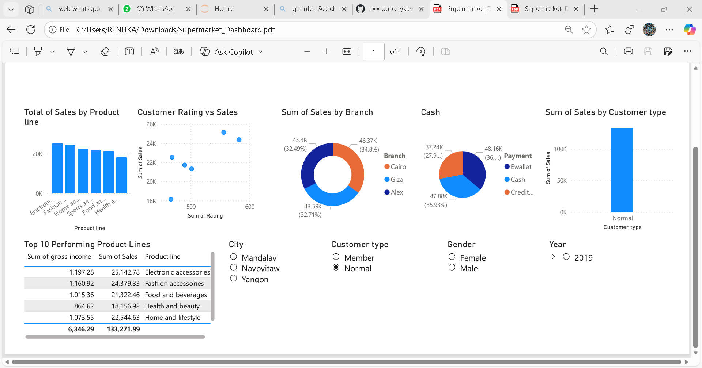

Slide 3
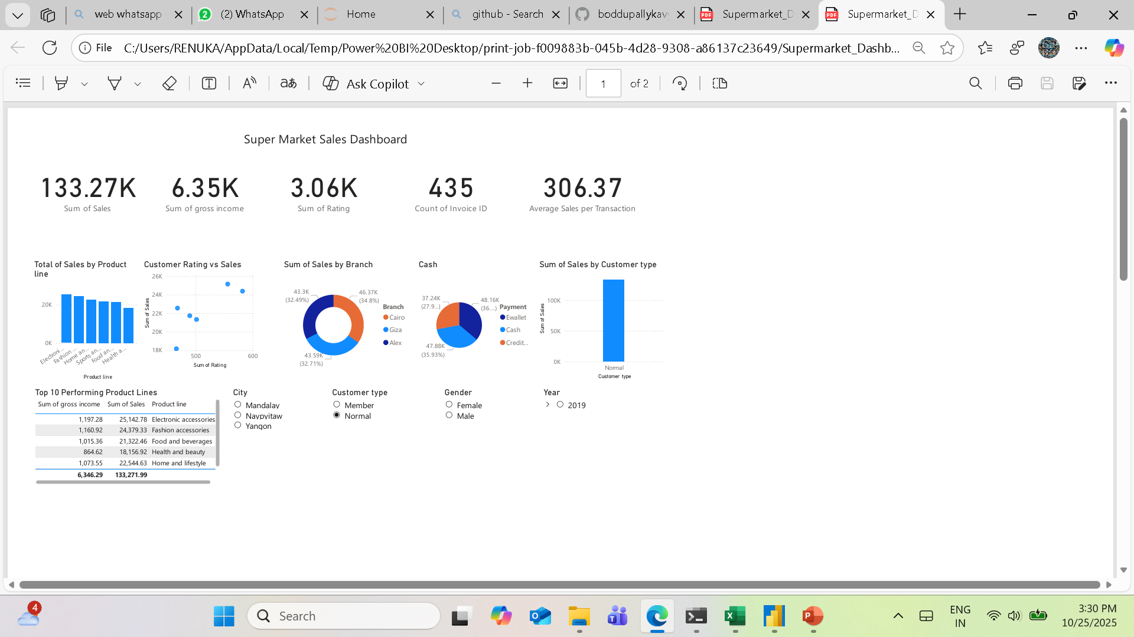
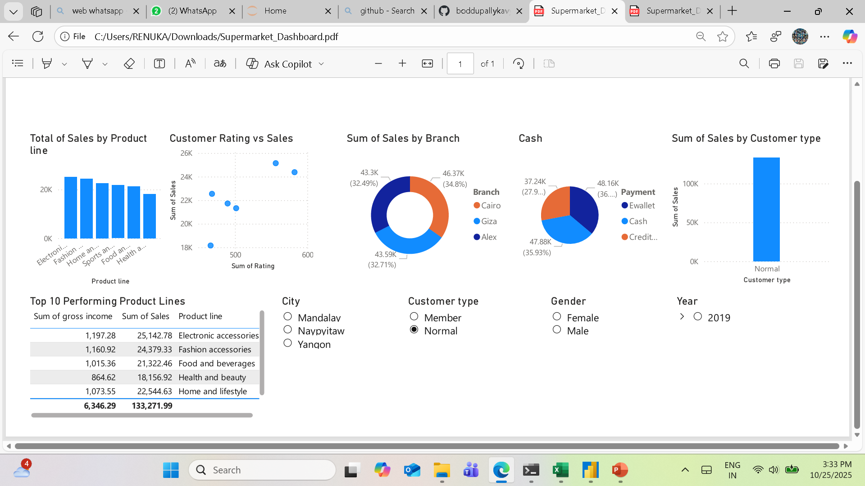
KPIs & Dashboard Layout Main KPIs: Total Sales: 133.27 KGross Income: 6.35K Transactions: 435 Average Sales per Transaction: 306.37 Average Rating: 3.06 Dashboard Features: - Interactivity through slicers (Date, City, Customer Type, Gender, Payment, Product Line) - Clear layout with KPI cards, charts, and filters on a single page - Time series trend analysis, top product performance, and branch comparisons

Slide 4
Key Insights Branch Performance: Alex branch leads in total sales (≈46.37K), followed by Cairo and Giza. Product Line Insights: Electronic Accessories is the top‑selling category; Fashion Accessories ranks second. Customer Behavior: Normal customers generate more total revenue than Members. E‑wallet and Cash are the most used payment methods. Customer Satisfaction: Average customer rating: 3.06. Higher-rated transactions often align with higher sales volumes.

